Slide 1
PCleaner
Swimming Pools Daily Care

Slide 2
Team Members
Philopatear Salib
Ahmed Amr
Nourhan Ayman

Slide 3
Contents
Application
Conceptual Design
Mechanical
Actuator Sizing
Stability
Electrical System
Safety
Software Architecture
Manufacturing
Estimated Budget
Timeline

Slide 4
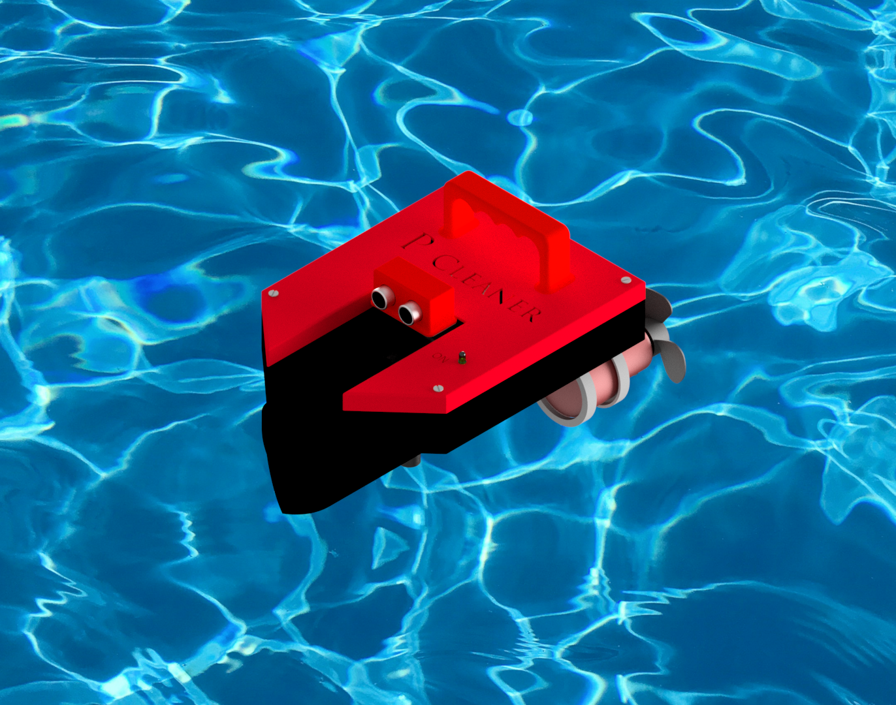
Application & User Interface
Swimming pool daily care mobile robot. Removes insects and dry leaves floating on water surface.
User connects a regular a socket to an AC power plug, place it in water, and presses the start button.

Slide 5
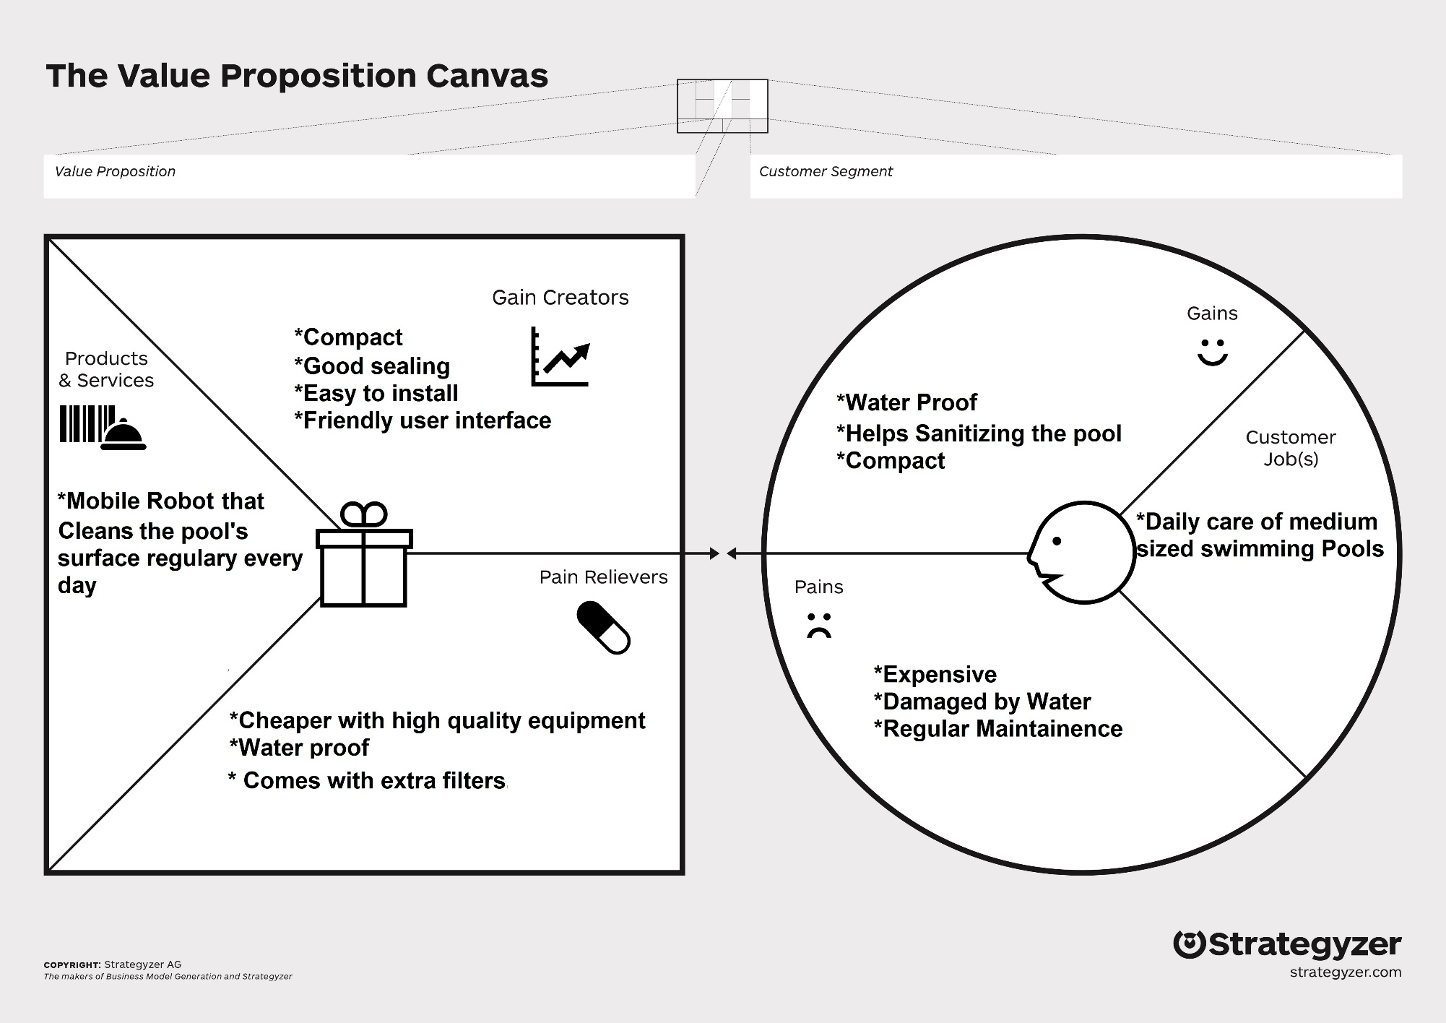
Business models

Slide 6
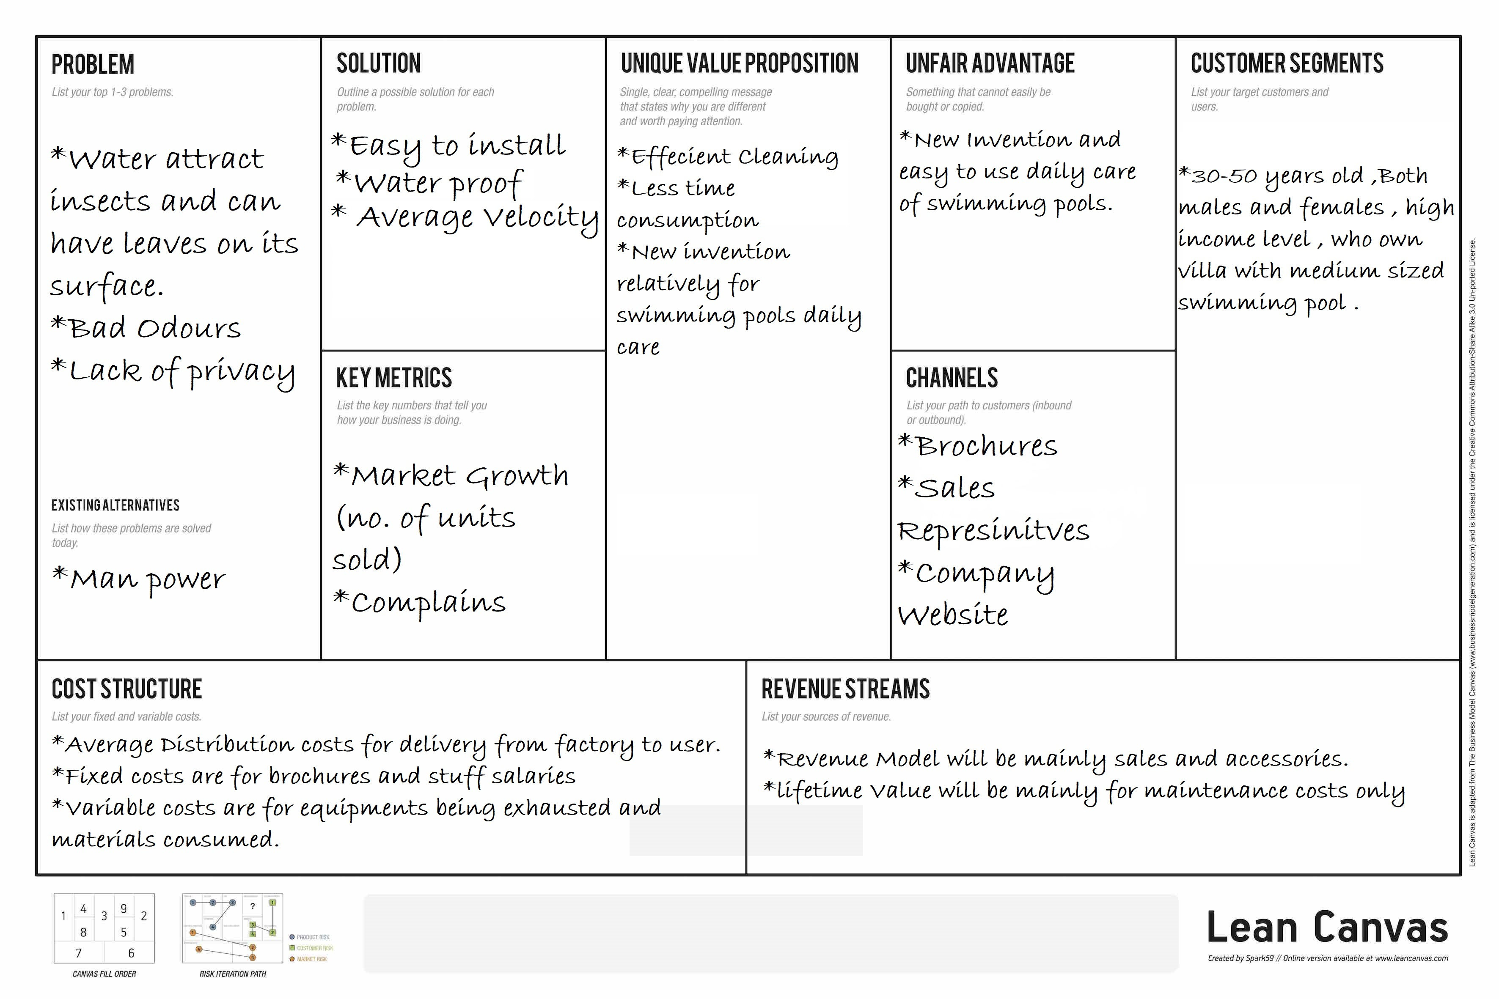
Lean Canvas

Slide 7
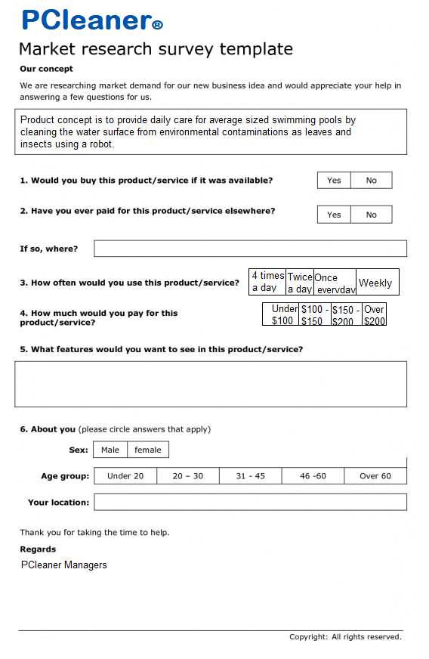
Market Research Survey
Product concept is to provide daily care for average sized swimming pools by cleaning the water surface from environmental contaminations as leaves and insects using a mobile robot.

Slide 8
Survey Results

Slide 9
Human-machine interface
*image of new rendered image of handle and LED*
Ergonomics and usability
A handle is made that fits average hands’ size, placed in the exact center of the product weight.
On/Off Button and a LED is used to indicate if the robot is in operation.

Slide 10
Rendered Image
*Rendered Image*

Slide 11
Conceptual Design
Minimizing Drag Force
Collecting rubbish by Water Suction

Slide 12
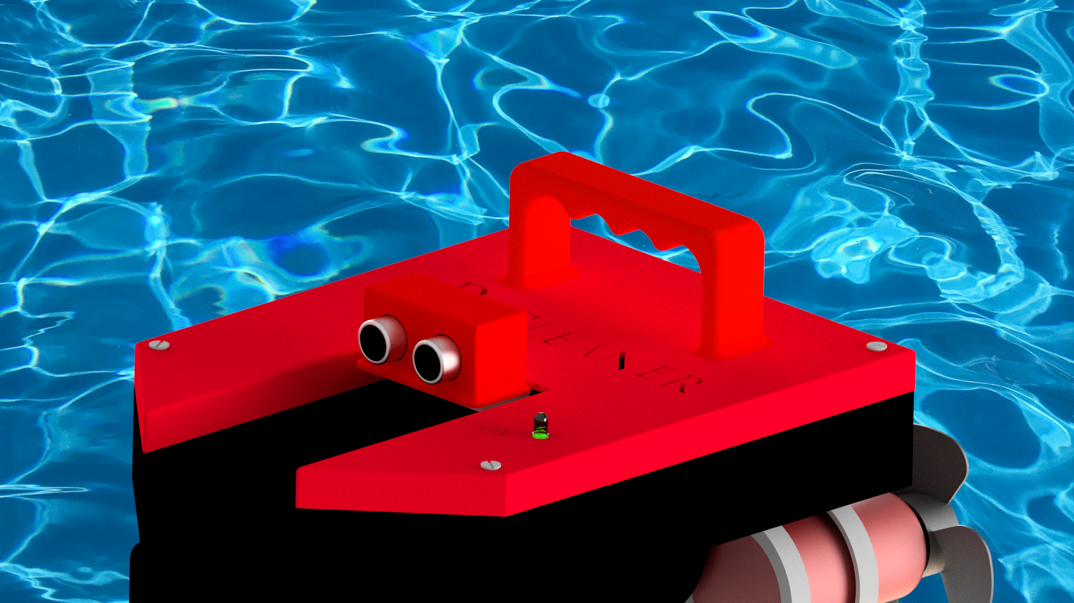
Mechanical Design
CAD Model

Slide 13
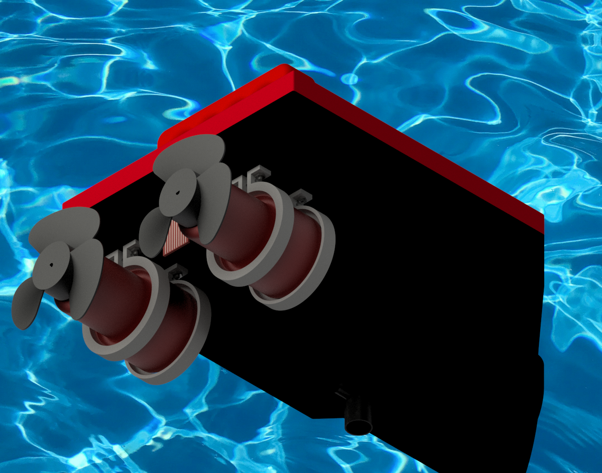
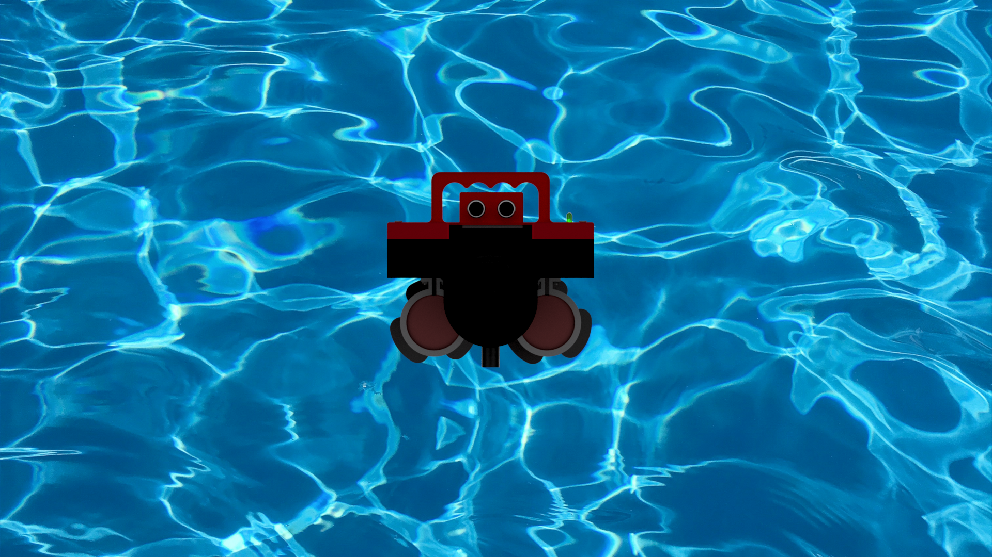
Mechanical Design
CAD Model

Slide 14
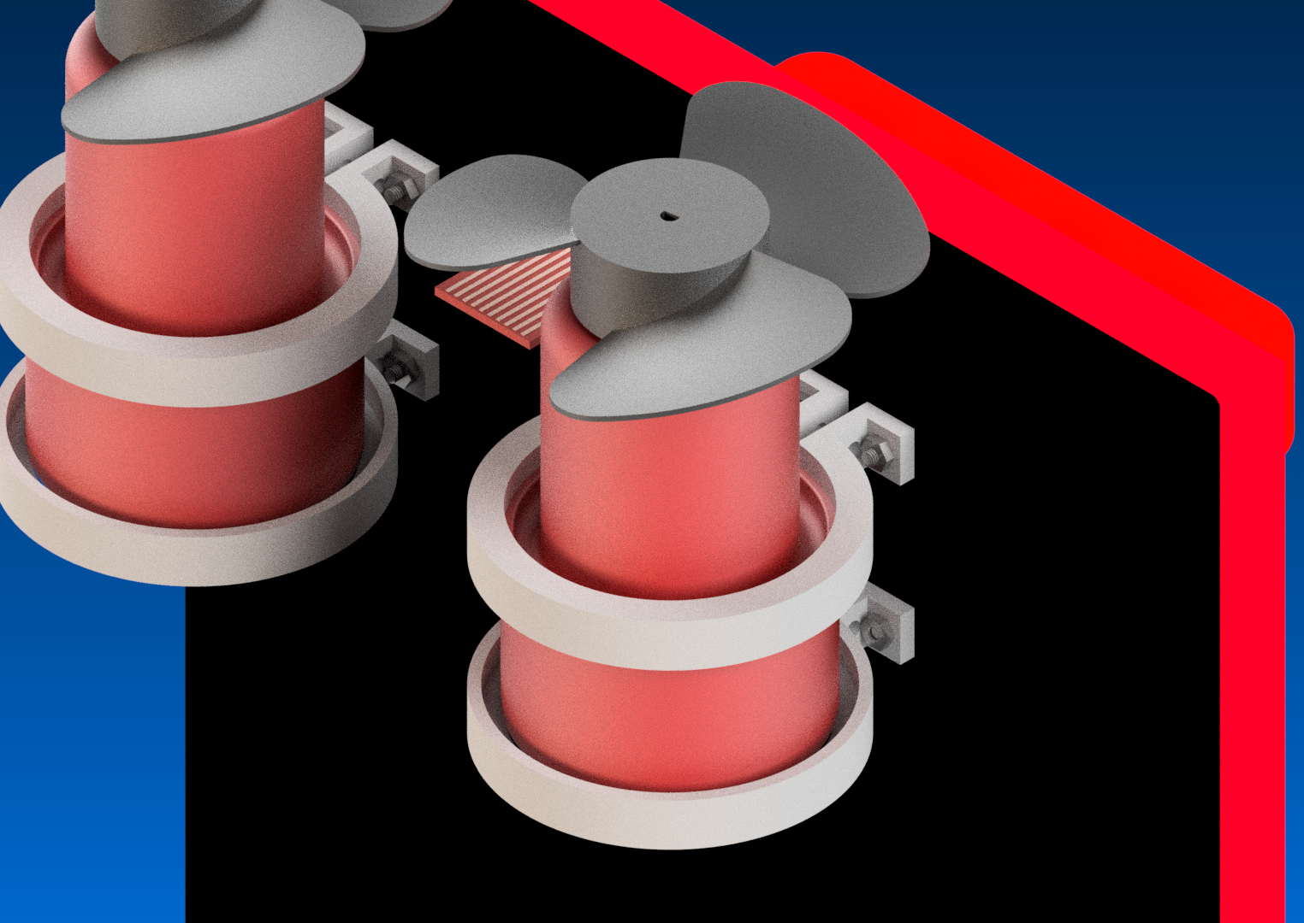
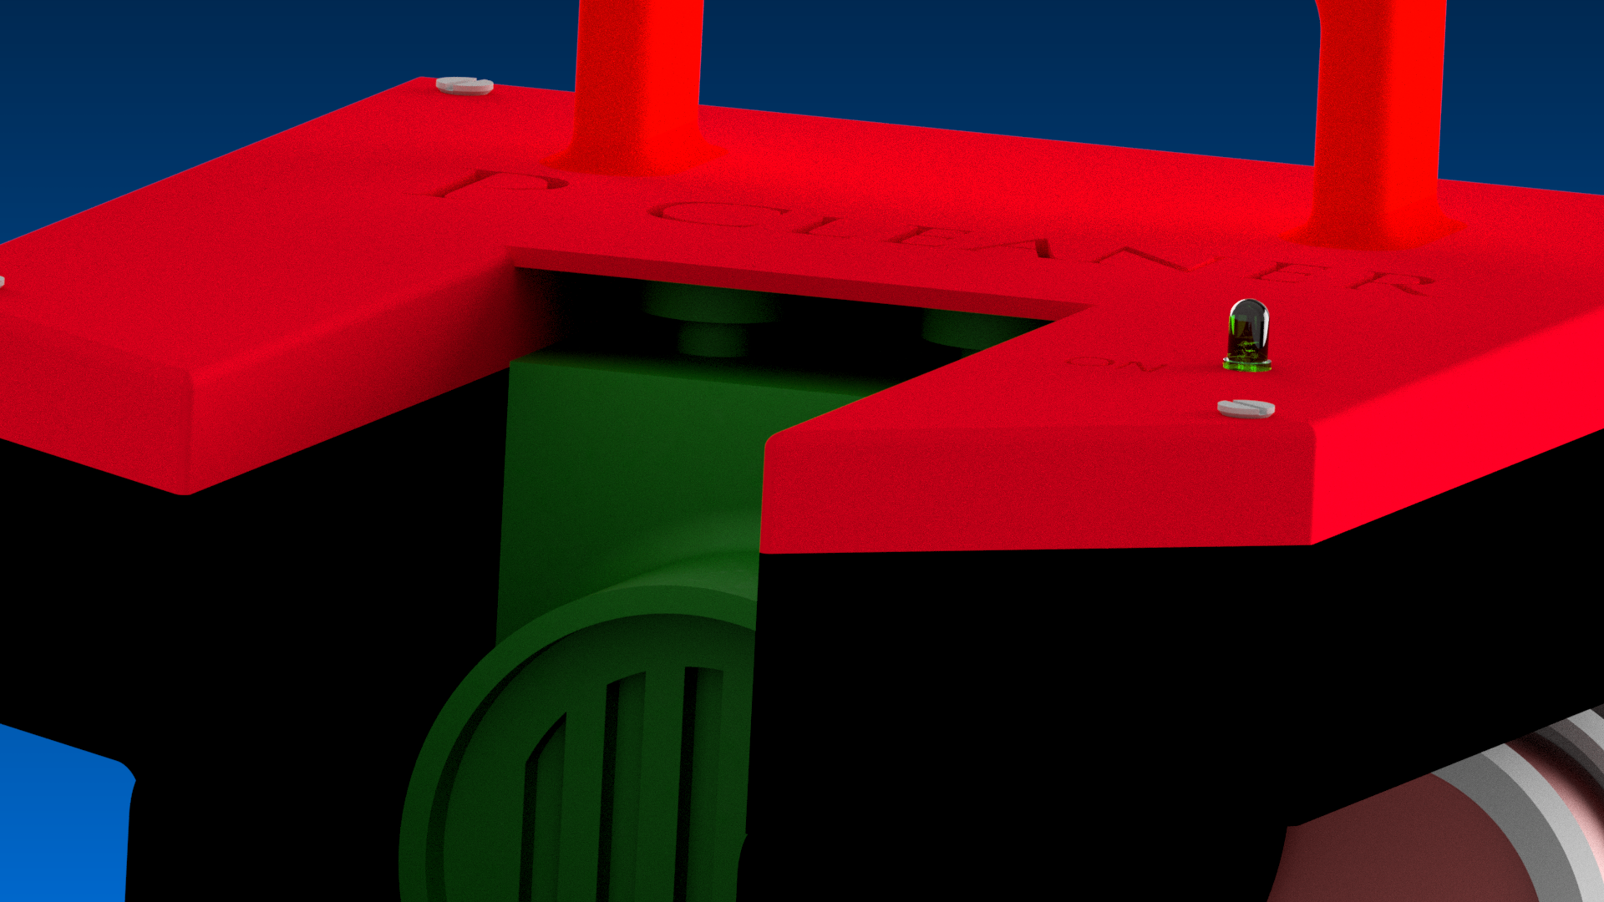
Mechanical Design
Filter and thrusters fixation

Slide 15
Mechanical Design
Top and bottom fixations

Slide 16
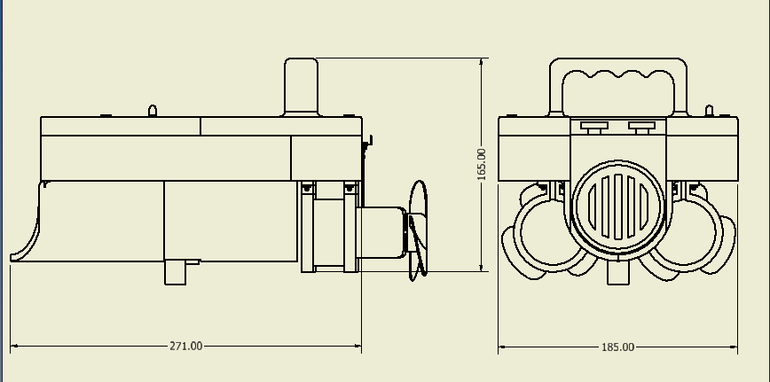
Mechanical Design
Over all dimension

Slide 17
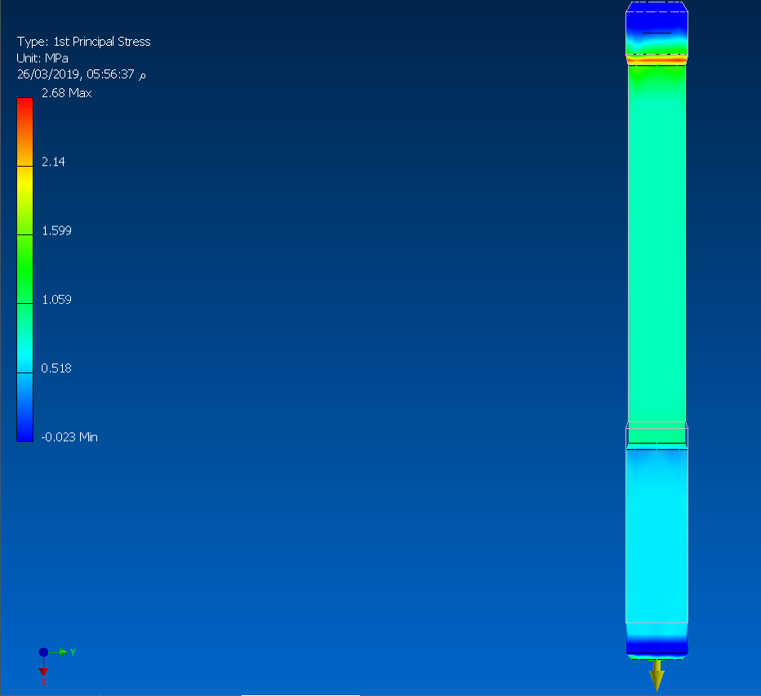
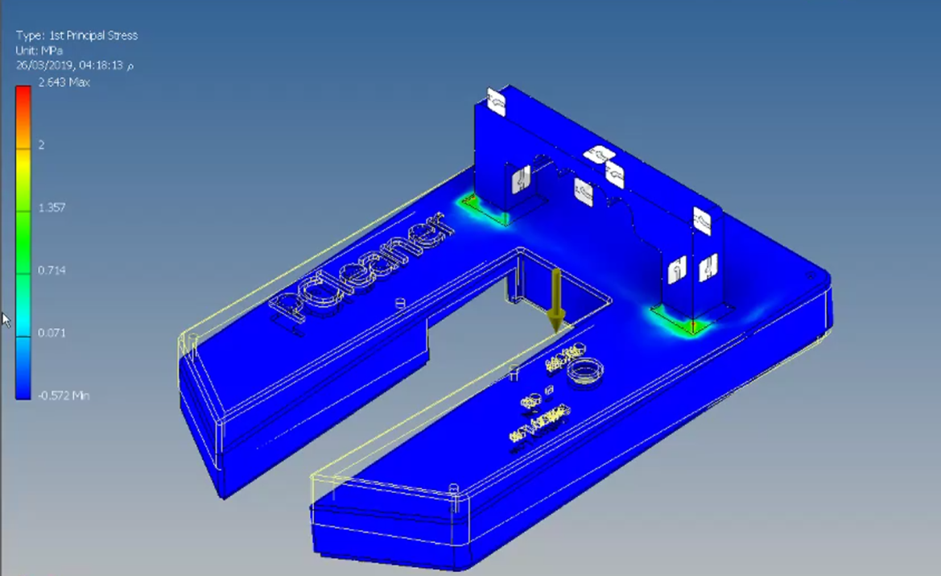
Mechanical Design
Stress analysis on chassis and bolts

Slide 18
Actuator Sizing
Hand Calculations
Available thrusters are just too big for our application
Replacing a centrifugal pump impeller with a propeller is a solution
Assuming maximum velocity = 0.2m/s < 1km/h and drag force = 0.32N
Suitable pumps required for each thruster of flow rate of 55.5 l/min
Suitable pumps available were of flow rate of 63 l/min
Those pumps with propellers of about 73 mm, together, provided a thrust of 0.462 N
Resulted in a theoretical maximum velocity of 0.42 m/s = 1.5 km/h

Slide 19
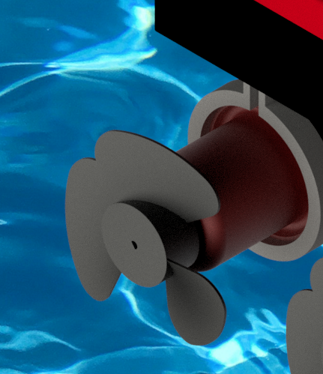
Actuator Sizing
Simulink (Simscape Model – Velocity Control)
Set point is compared to the signal coming from the system, and the error is fed to the PID controller . The output of the PID fed to the motor driver which controls the motor using the PWM technique, while the motor shaft rotates. The centrifugal pump being drove by the motor and from its flow rate, and velocity outlet is obtained. Thus we can obtain thrusters force and the drag force due to the vehicle velocity, thus calculating the resultant thrust acting on vehicle.

Slide 20
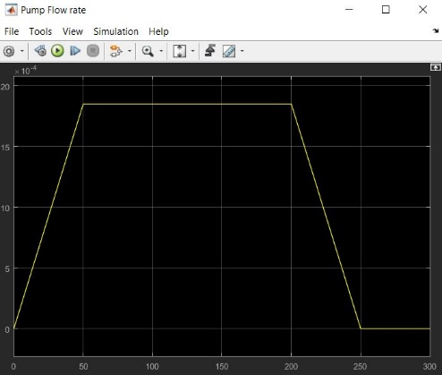
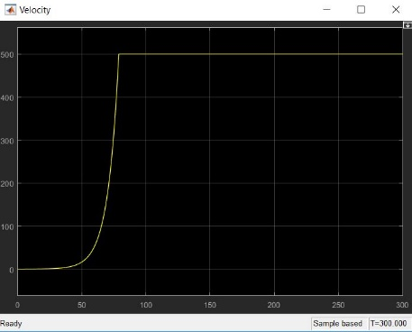

Slide 21
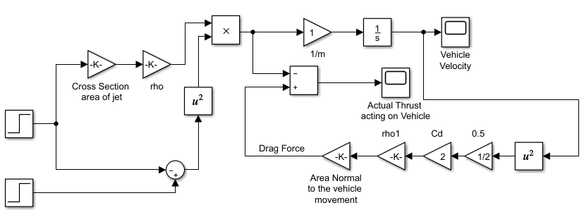
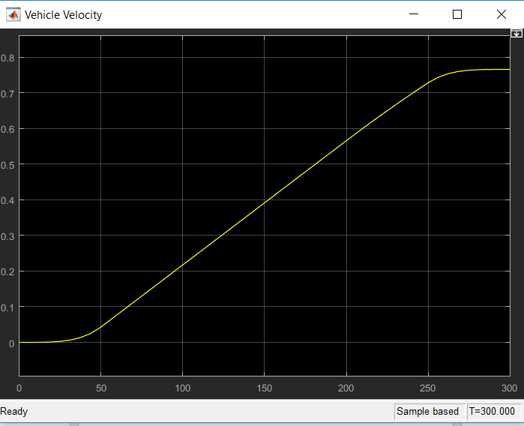
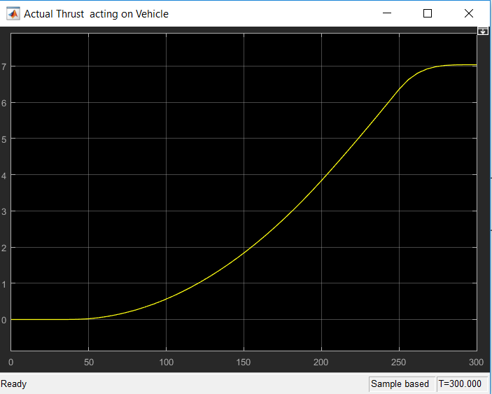
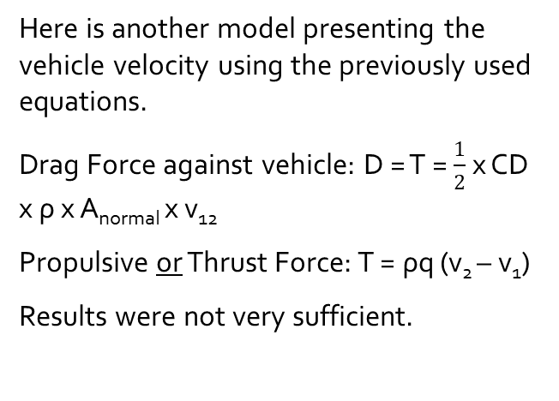
Simplified Model
Here is another model presenting the vehicle velocity using the previously used equations.
Drag Force against vehicle: D = T = $\frac{1}{2}$ x CD x ρ x A_{normal} x v₁₂
Propulsive or Thrust Force: T = ρq (v₂ – v₁)
Results were not very sufficient.

Slide 22
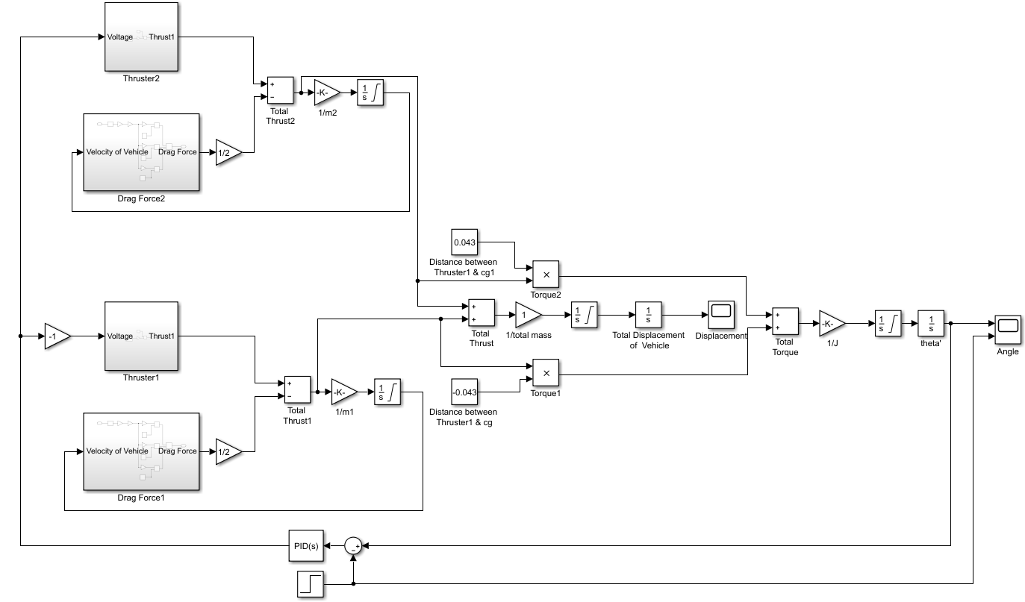
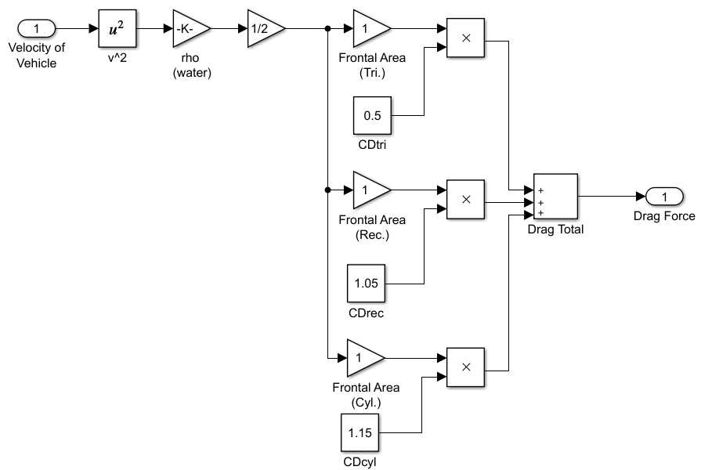
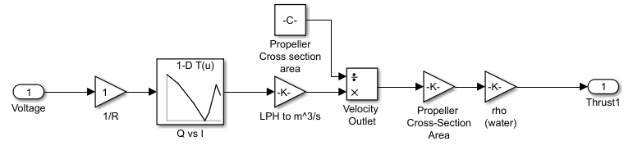
Path Generation
Using MATLab, this model shown simulated the control of the vehicle yaw angle using an IMU.

Slide 23
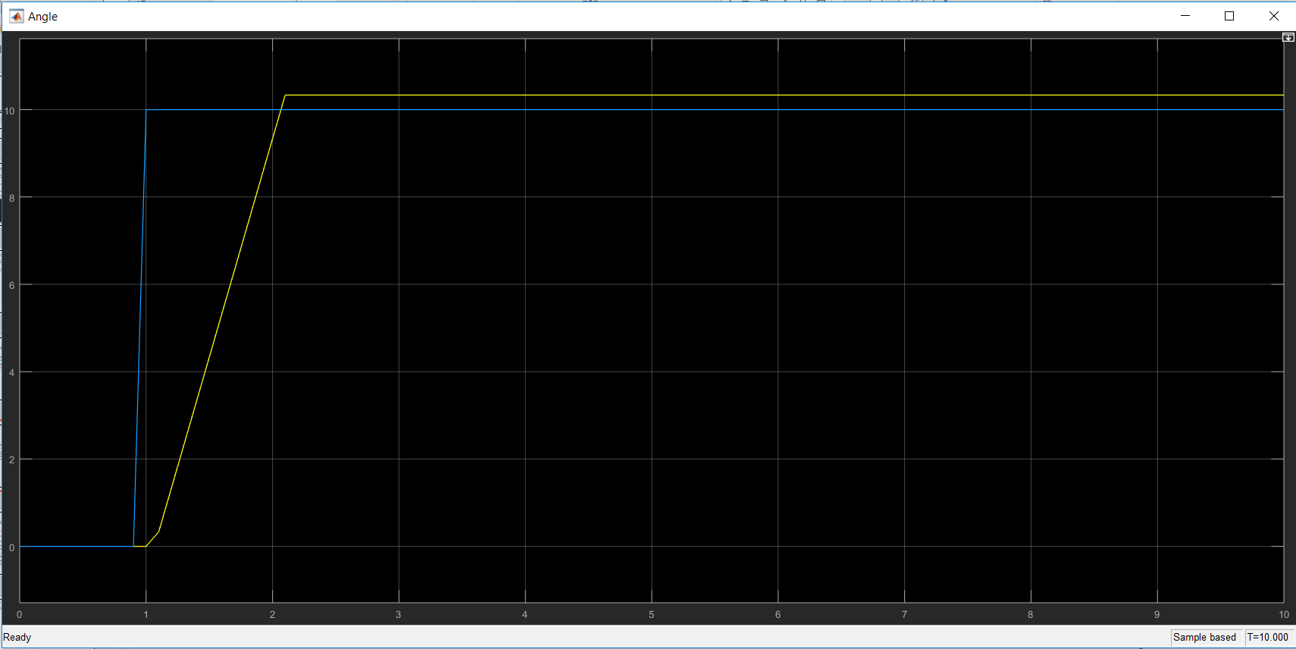
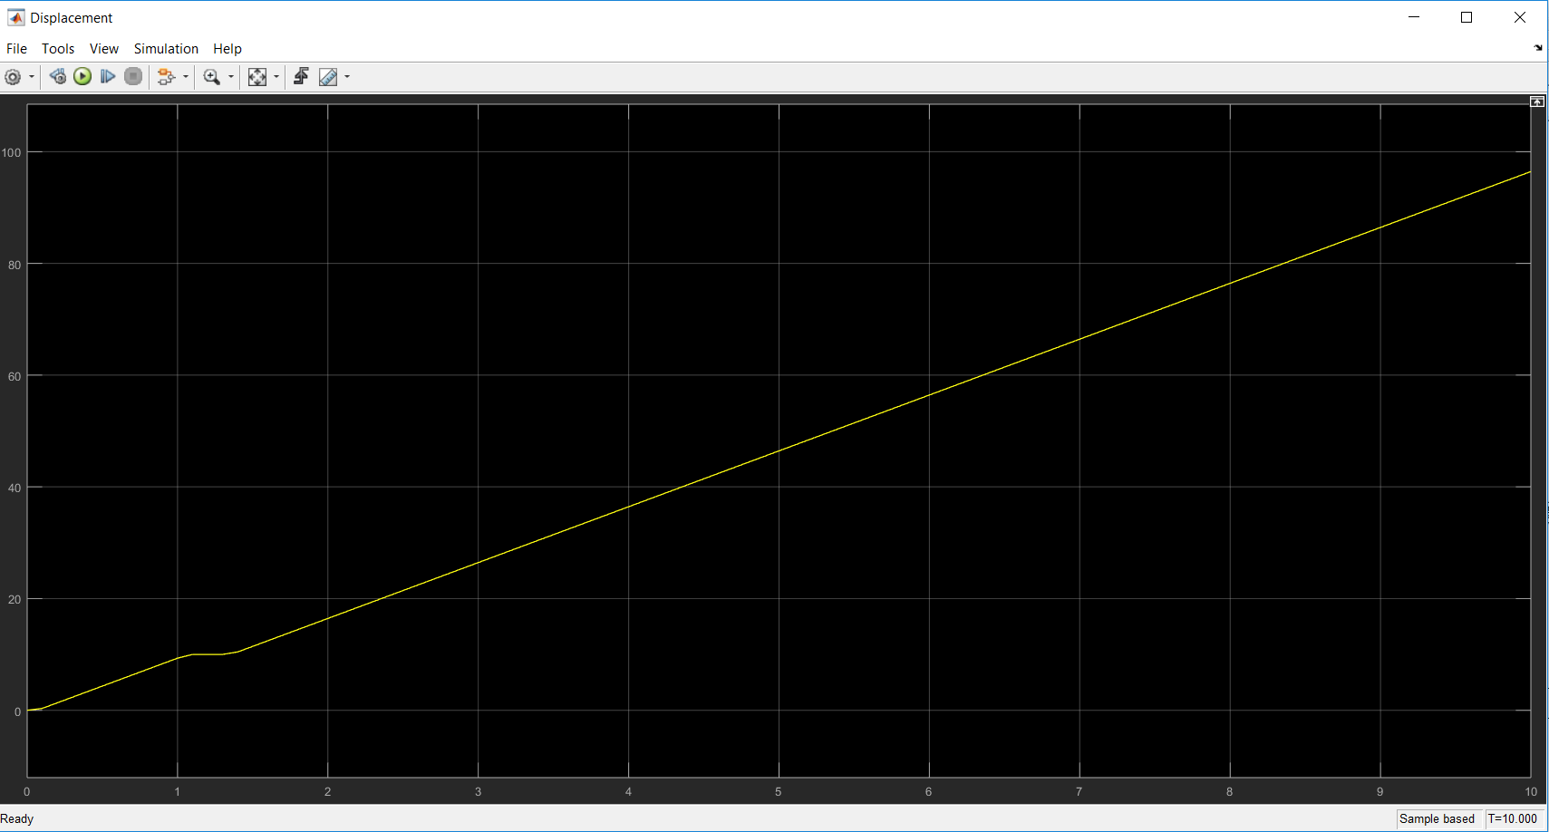
Path Generation
Those results were the most successful and the most logical of all MATLab models.
The PID parameters are tuned using Zeigler-Nicholas method, and a Kp = 10.15, Ki = 20.19, and Kd = 0.446 are obtained.

Slide 24
Stability
To achieve equilibrium while robot is in positive buoyancy, it has been found that the maximum mass robot can tolerate without sinking is m_{max} = 3.54 kg.
To avoid robot toppling due to misalignment of center of gravity and center of buoyancy, a wide volume is left at the front of ship to allow addition of variable weight.

Slide 25
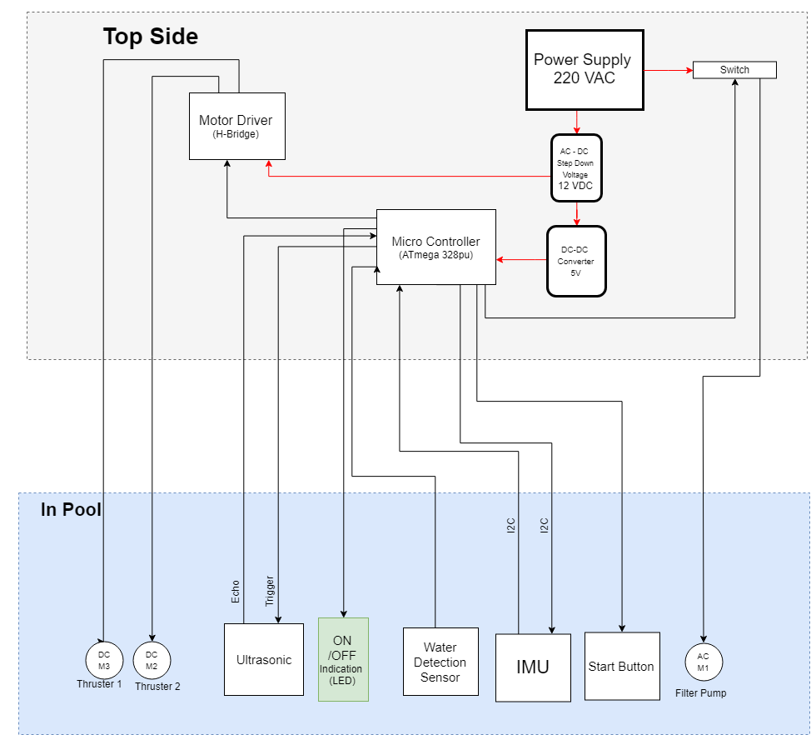
Electrical Design
SID

Slide 26
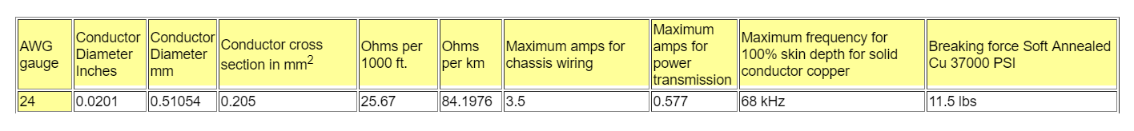
Electrical Design
Wire sizing & Power Sizing
Since the thrusters are the most current consuming of about 3.2 A per Thruster. Thus 24 AWG wires are used to meet the requirements of thrusters’ current.
Total power consumption of components without any loss about 80W.
Total power consumptions considering losses due to AC to DC Converters, Buck Converter, and wires is about 103W.

Slide 27
Safety
Since AC is used to power this robot, high level of safety is considered
Ready sealed products are only present in water.
High quality isolated wires.
All Electronic components are separated in a water proof box out of water, that also allowed easy heat dissipation due to great stepping down of voltage.
A water sensor is used to detect if there’s any leakage in the electronic components box.
Also another water sensor is used to assure that even if the start button is pressed but the robot isn’t placed in a suitable level of water, it won’t operate.

Slide 28
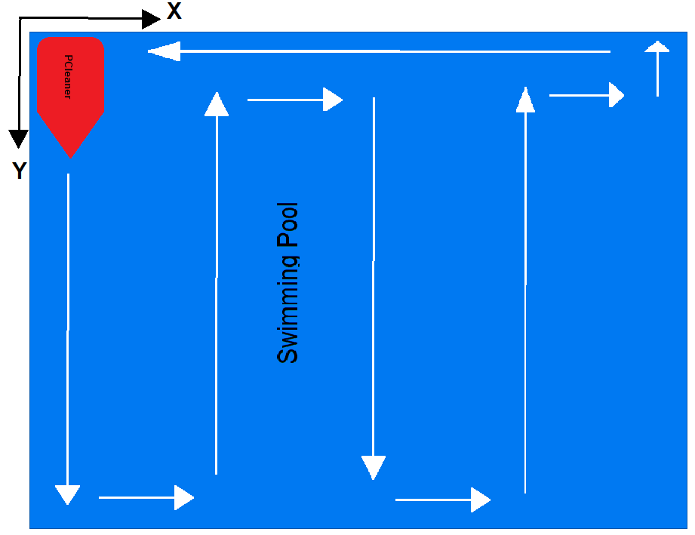
Software Design
Concept
Main concept of the software design is that the dimensions of the rectangular average sized swimming pool will be previously known and the robot will be pre-programmed before it’s handled to customer. Thus just by changing the width and the length and re-burning the code to the microcontroller, the robot autonomously will be able to calculate the number of turns required to clean the pool and return back to the start point, thus being ready for another trip through the swimming pool.

Slide 29
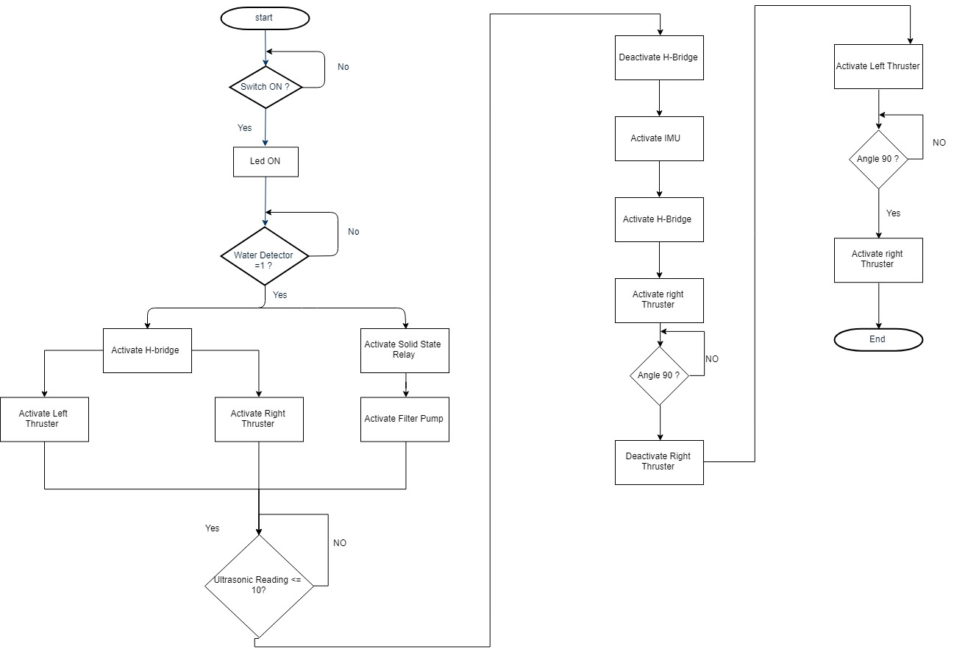
Software Design
Flow chart
The PID controls the PWM of the thrusters according to the IMU readings compared to the set point fed to the microcontroller. The PID parameters are tuned using Zeigler-Nicholas method, and a Kp = 10.15, Ki = 20.19, and Kd = 0.446 are obtained.

Slide 30
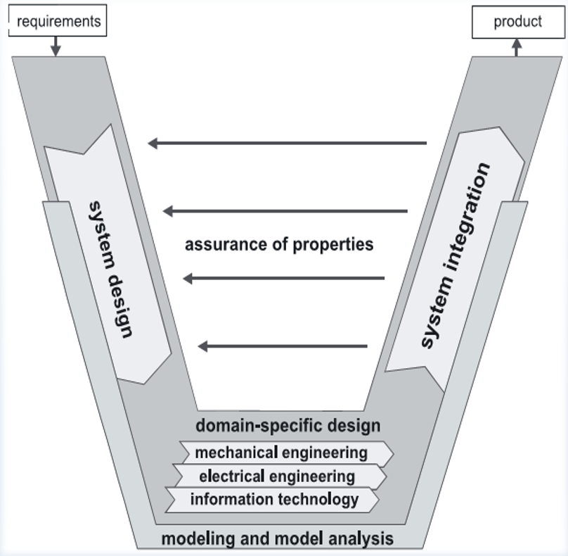
Project Plan
We’ve followed the VDI 2206 standard which describes the logical sequence of important sub steps in the development of a mechatronic system.

Slide 31
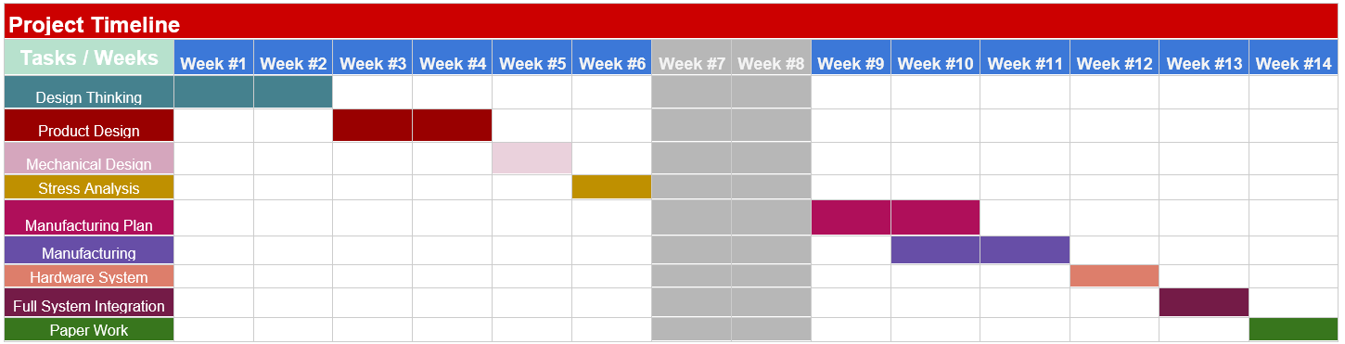
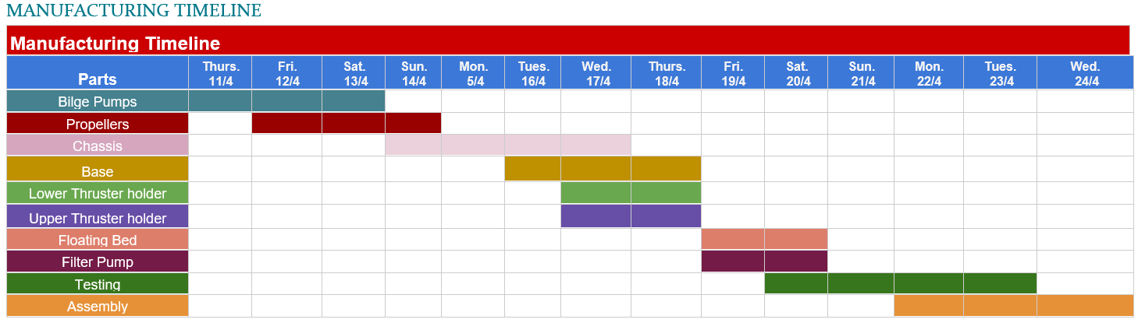
Project Timeline
Manufacturing Timeline

Slide 32
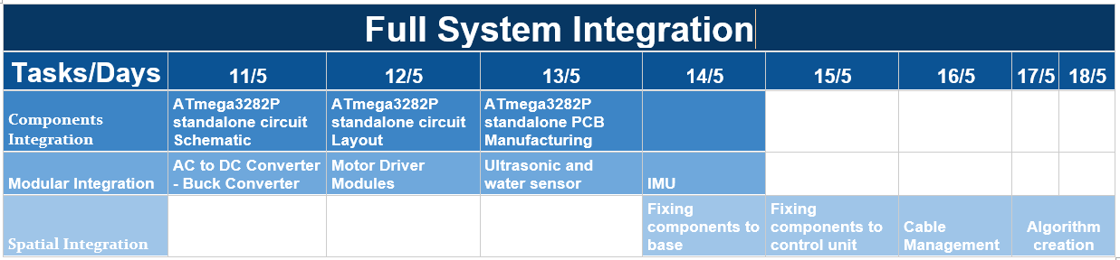
Integration Plan
Components Integration
A standalone circuit for the ATmega328 is made and manufactured from scratch.
Modular Integration
Motor driver module, buck converter modules, AC to DC converter, alongside with the water sensor, ultrasonic, and IMU modules are integrated together with the microcontroller performing the whole circuit fully functioning while creating the suitable algorithm for the system control.
Spatial Integration
Mechanical and electrical systems are integrated together forming a fully functioning system. Cables inside the control unit and the inside the vehicle is managed properly.

Slide 33
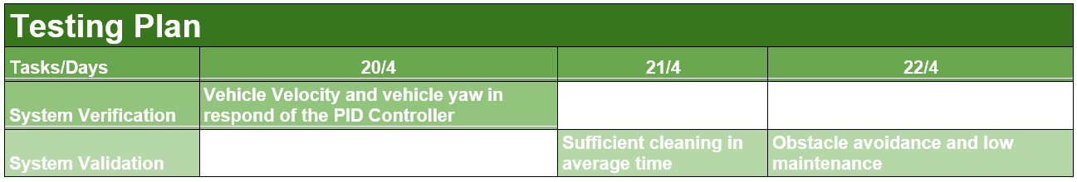
Testing Plan
System Verification
Thrusters, ultrasonic, water sensor, and filter pump responded correctly to the microcontroller signals and robot operated as expected. IMU had some issues concerning its calibration and noisy signals, but that is overcame using a Kalman filter.
System Validation
Robot functioned as good as a prototype would function to prove the concept of a whole newly idea. Robot cleaned an area of about 2m² in less than 30 seconds.

Slide 34
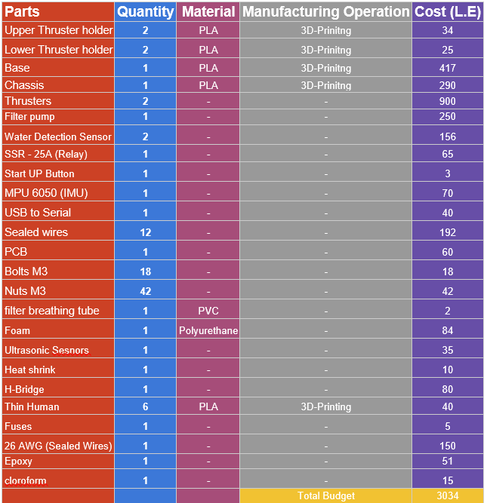
Estimated Budget
A Low Budget criteria is mainly used for this project that resulted in a project that costed around 3000 L.E.
Manufacturing
We have used 3D-printer in manufacturing most of our parts since it allows the control of each part density and printed most of the parts on our previously made 3D-Printer which allowed us to save about 25% of the cost.
Electrical components
A second hand bilge pump is bought, thus we saved about 800L.E. 2 dual channel motor drivers tolerating 4A each were way cheaper than the available motor driver that tolerated till 30A.

Slide 35
Thank you

